Slide 1





COUSTOMER SEGMENTATION AND PERSONALIZATION
Team : M. KISHORE KUMAR,kishore995247@gmail.com.
Guide:(P. Raja, Master Trainer, Edu net Foundation)
Disclaimer: The content is curated for educational purposes only.
Notes:
Slides: Prepare a short slide deck (10-12 slides) summarizing the project objectives, methodology, and key results.

Slide 2
OUTLINE
Abstract of the Project
Problem Statement
Proposed Solution
System Architecture
Live Demo of the Project
Embedded Video of Project
Conclusion
Future Scope

Slide 3
Abstract
This paper explores the application of Artificial Intelligence (AI) techniques for customer segmentation and personalization to enhance customer engagement and optimize marketing strategies. By leveraging customer data, including preferences, behaviors, and purchase history, AI-driven models enable the segmentation of customers into distinct groups with shared characteristics. These segments allow for a more nuanced understanding of customer needs and enable personalized recommendations and targeted marketing campaigns, improving both customer satisfaction and business outcomes. Key AI techniques, such as machine learning algorithms, clustering, and recommendation systems, are discussed in the context of their role in creating dynamic and personalized customer experiences. The findings indicate that adopting AI for customer segmentation and personalization can lead to significant increases in customer engagement, conversion rates, and long-term brand loyalty.

Slide 4
Problem Statement
In today’s competitive market, businesses struggle with delivering relevant marketing messages to individual customers. Traditional segmentation methods often fail to capture the full spectrum of customer behaviors, leading to ineffective marketing strategies and missed revenue opportunities. Without accurate and actionable insights, companies risk alienating customers with irrelevant or untimely messages. The challenge is to leverage vast and diverse customer data to create dynamic segments and develop personalized marketing strategies that resonate with each customer. This project aims to address these challenges by applying AI techniques to improve the accuracy of customer segmentation and personalization efforts, enabling businesses to target their audiences more effectively and efficiently.

Slide 5
Proposed Solution
1.Customer Segmentation Strategy: Data Collection, Segmentation Techniques, Creating Segments.
2.Personalization Strategy: Personalized Marketing Campaigns, Personalized Product Recommendations, Customized Offers and Discounts, Personalized Customer Support.
3.Data-Driven Technology & Tools: CRM Software (e.g., Salesforce, HubSpot),Customer Data Platform (CDP),Marketing Automation Tools (e.g., Marketo, Mail chimp, Personalization Engines (e.g., Dynamic Yield, Optimizely),AI and Machine Learning Algorithms.
4. Testing & Optimization: A/B Testing, Multivariate Testing, Continuous Feedback Loop.
5. Monitoring & Metrics:
Customer Lifetime Value (CLV),
Conversion Rate,
Engagement Metrics,
Customer Retention Rate,
ROI.

Slide 6
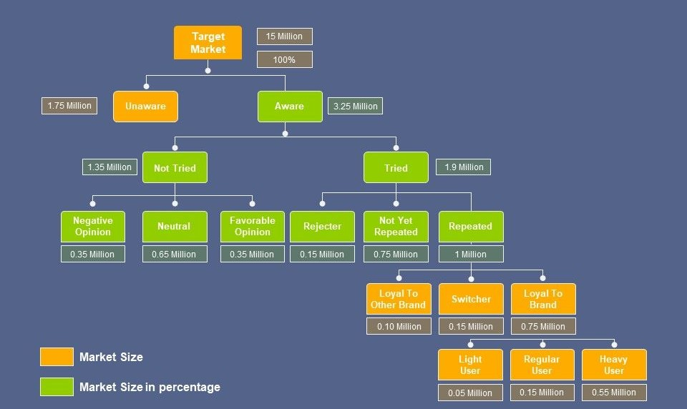
System Architecture

Slide 7
Live Demo of Project

Slide 8
Video of Project Demo

Slide 9
Conclusion
In conclusion, customer segmentation and personalization are essential strategies for delivering targeted, relevant experiences that drive customer satisfaction, loyalty, and business growth. By understanding the unique needs and behaviors of different customer groups, companies can tailor their marketing efforts to resonate more effectively, boosting engagement and conversion rates. Leveraging advanced technologies like AI and machine learning enables real-time personalization, optimizing both customer experiences and marketing ROI. Ultimately, a well-executed segmentation and personalization strategy helps businesses build stronger customer relationships, improve retention, and stay competitive in today’s dynamic market.

Slide 10
Future Scope
The future scope of customer segmentation and personalization lies in the continued evolution of AI, machine learning, and data analytics. As technologies advance, businesses will gain even deeper insights into customer behavior, enabling more granular and real-time personalization. The integration of omnichannel data will allow for seamless, cross-platform experiences, while predictive analytics will enable hyper-targeted strategies to anticipate customer needs. Furthermore, with the growing importance of privacy and ethical data use, businesses will need to balance personalization with trust, ensuring data security and transparency. The future promises even more dynamic, tailored customer experiences, driving deeper engagement and loyalty.

Slide 11
Thank you!
Notes:
thank you very much for joining this PPT, keep learning.
11

